Slide 1
InClass Assignment 8
Carlos Rosario

Slide 2
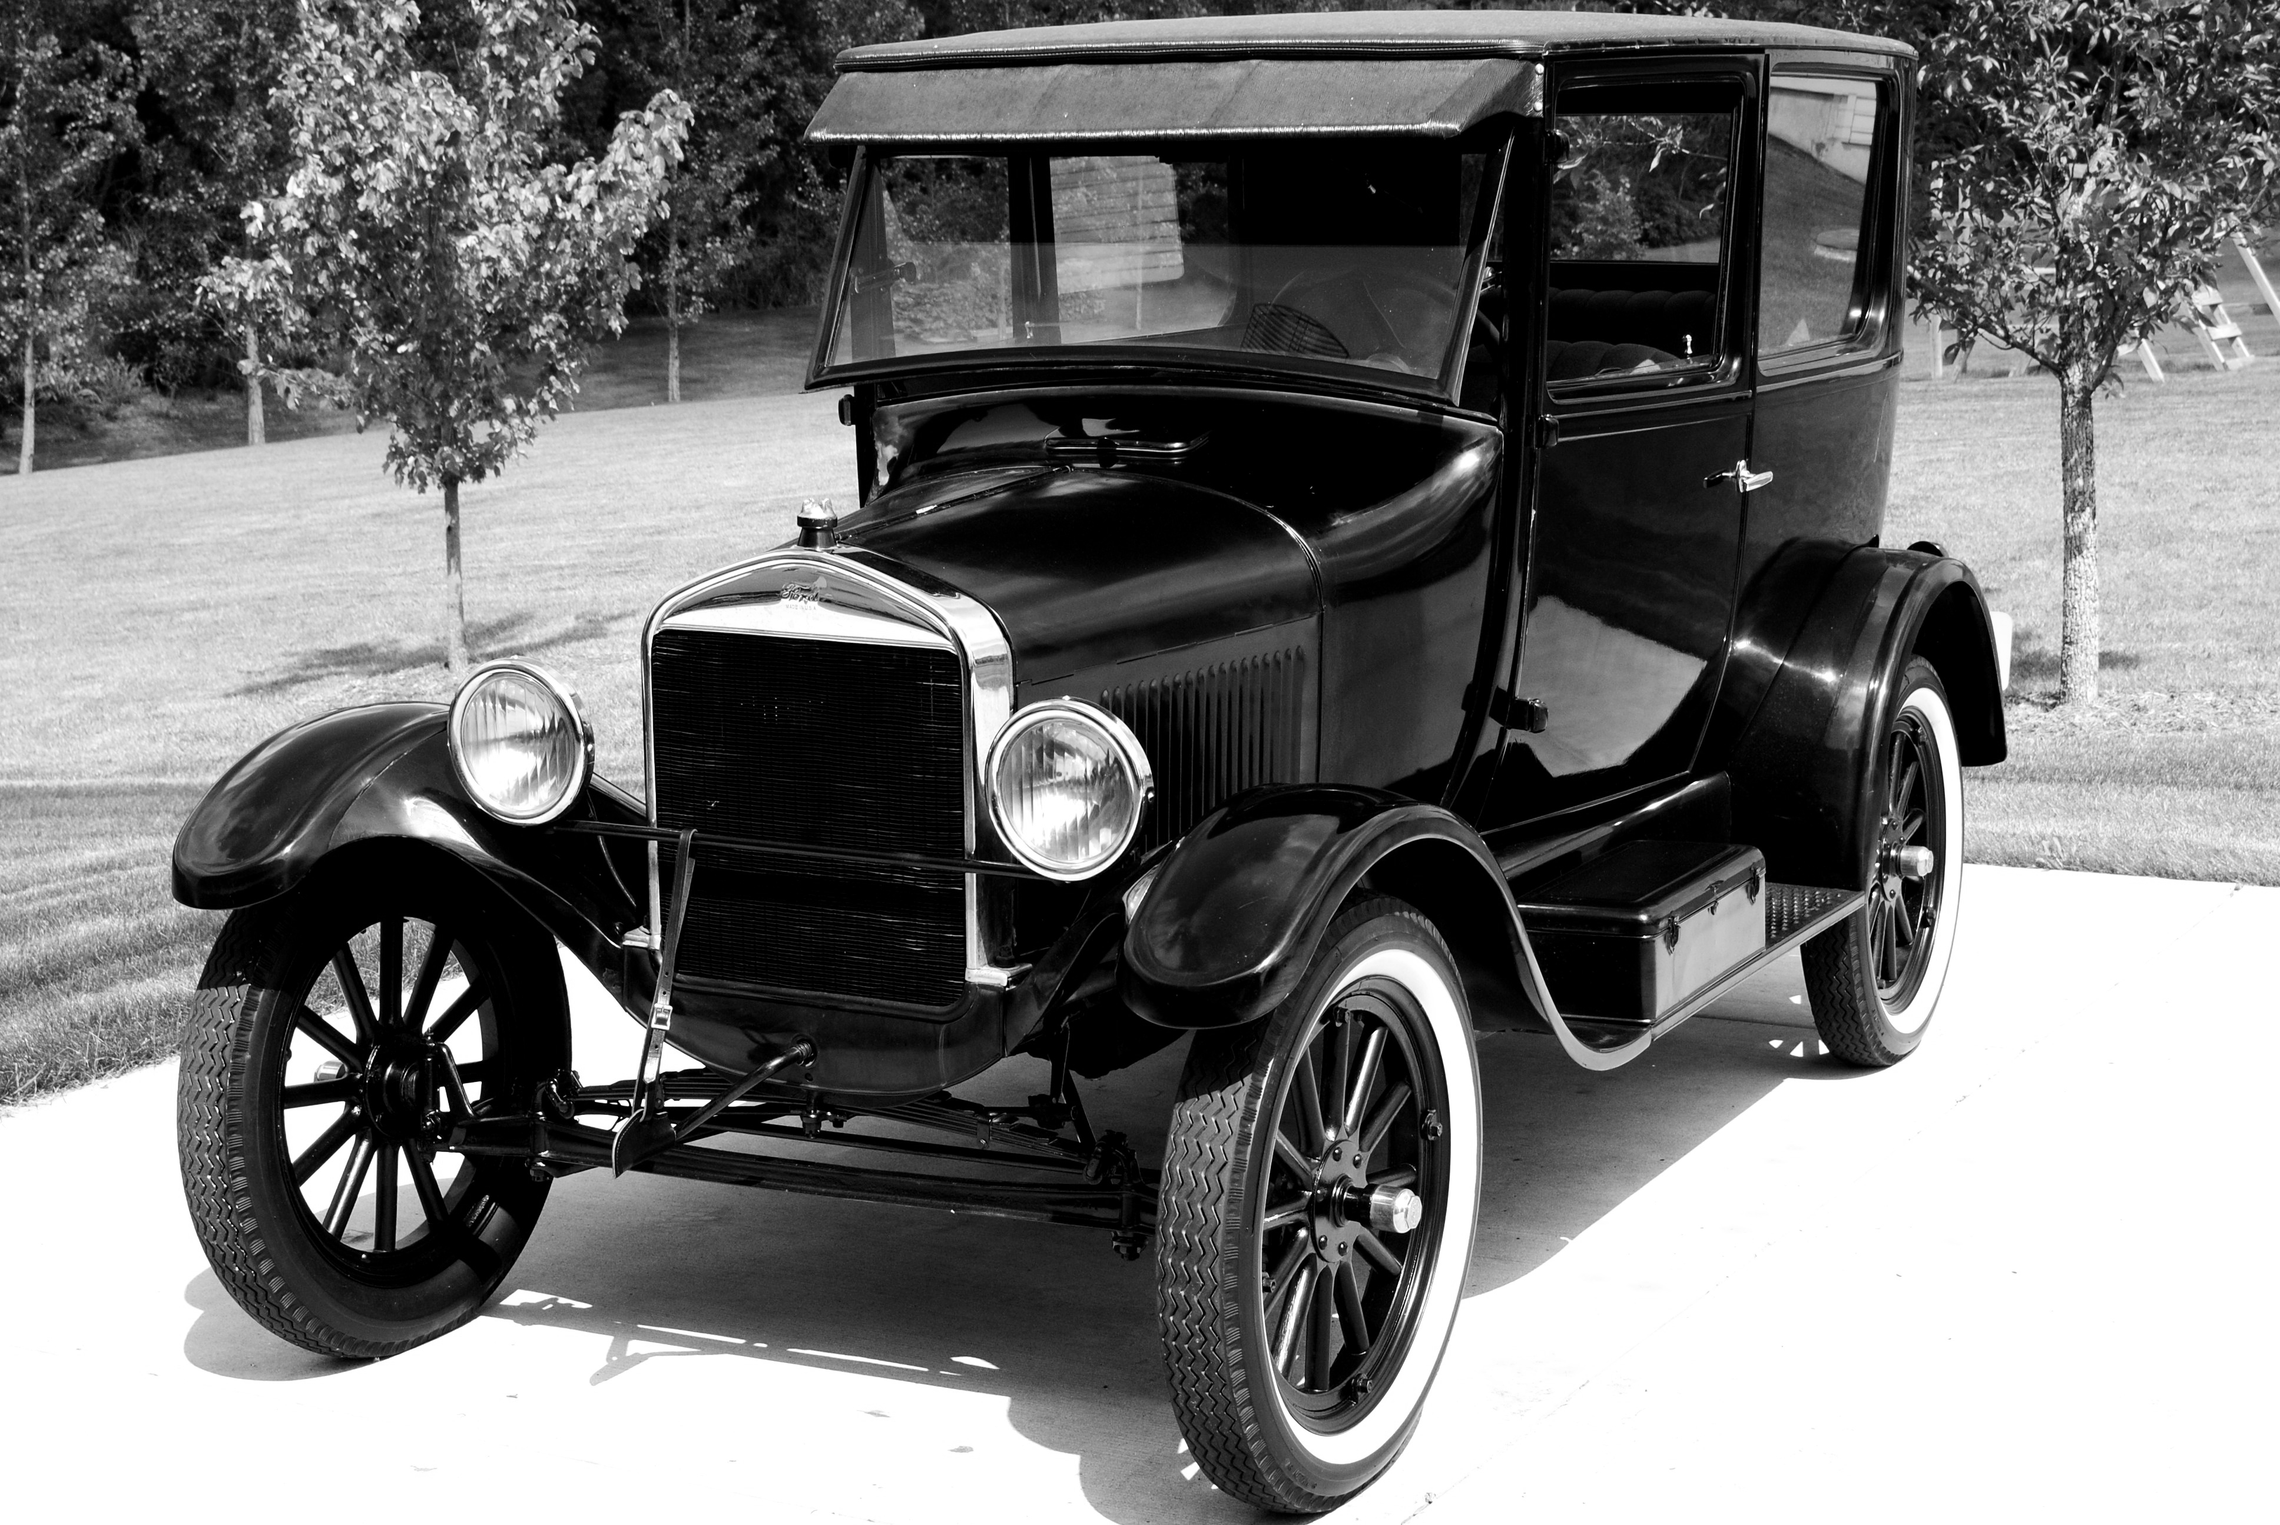
Input Image

Slide 3
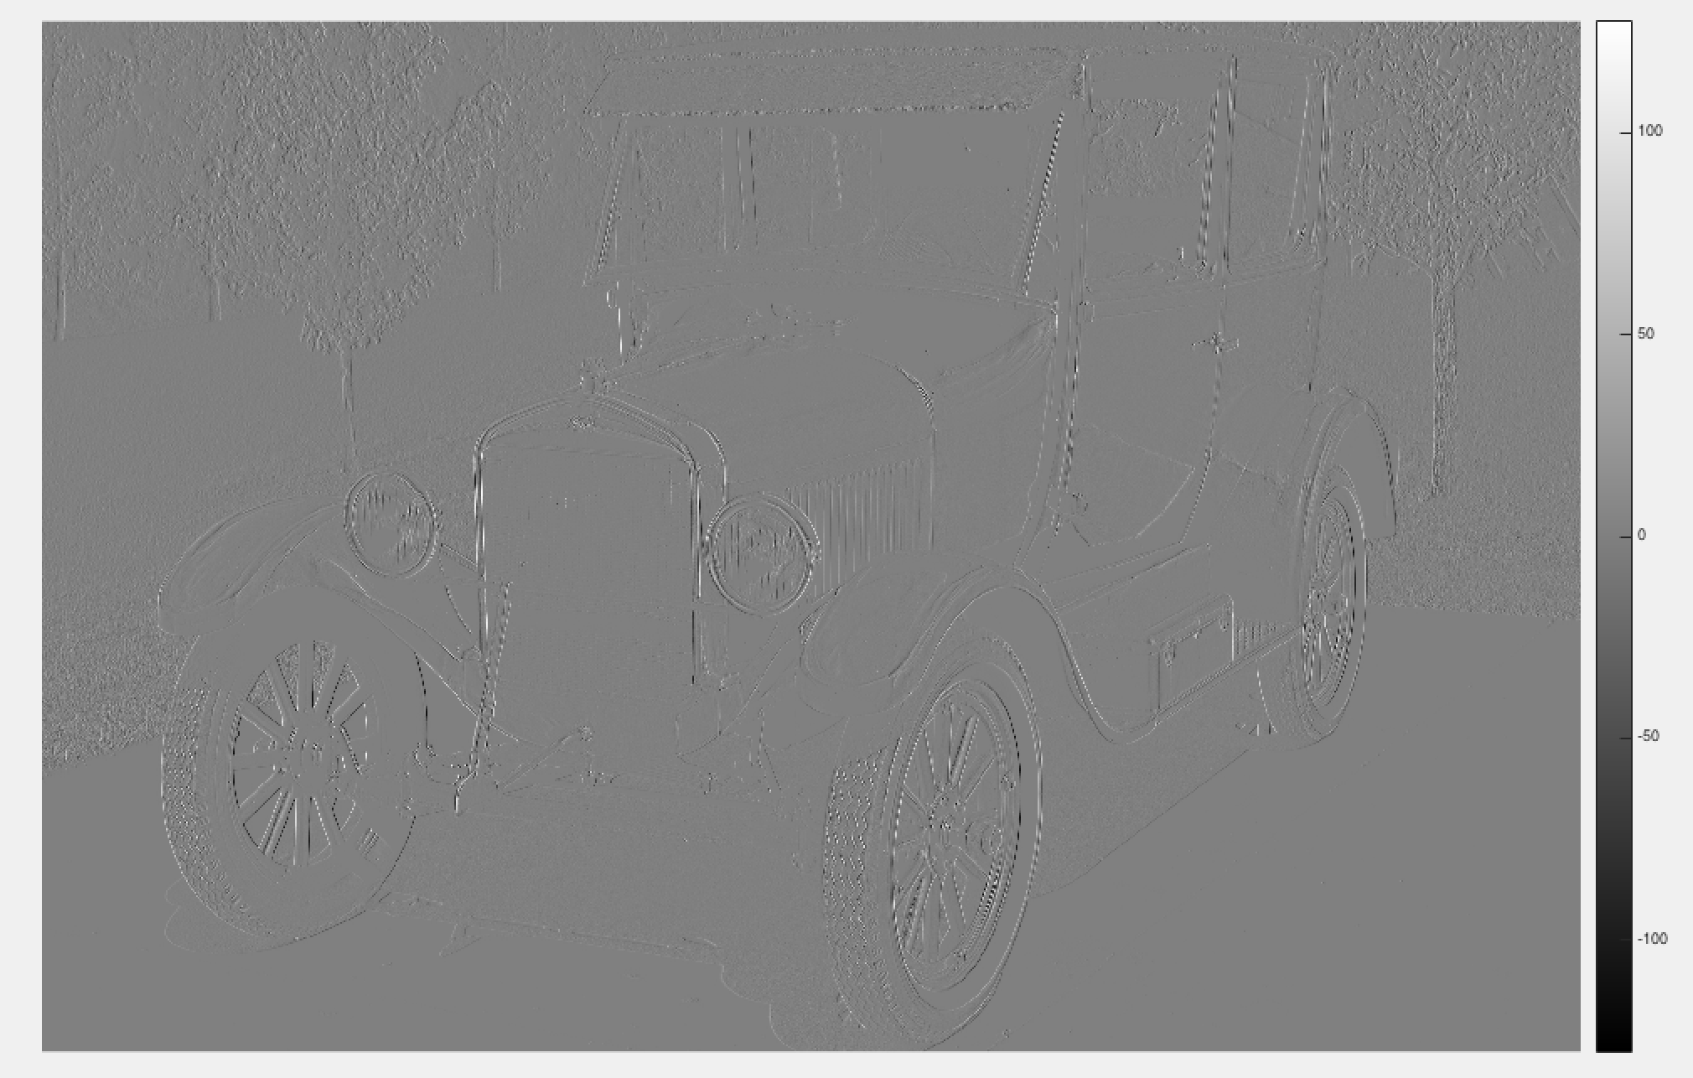
Visualization of gradient in x direction

Slide 4
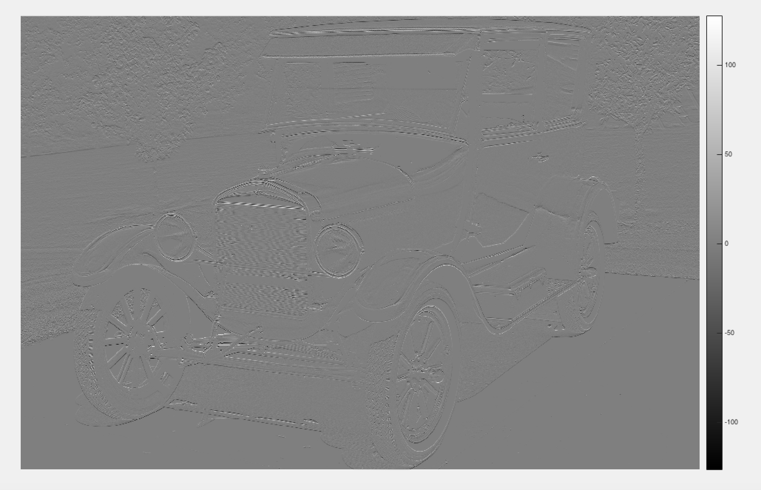
Visualization of gradient in y direction

Slide 5
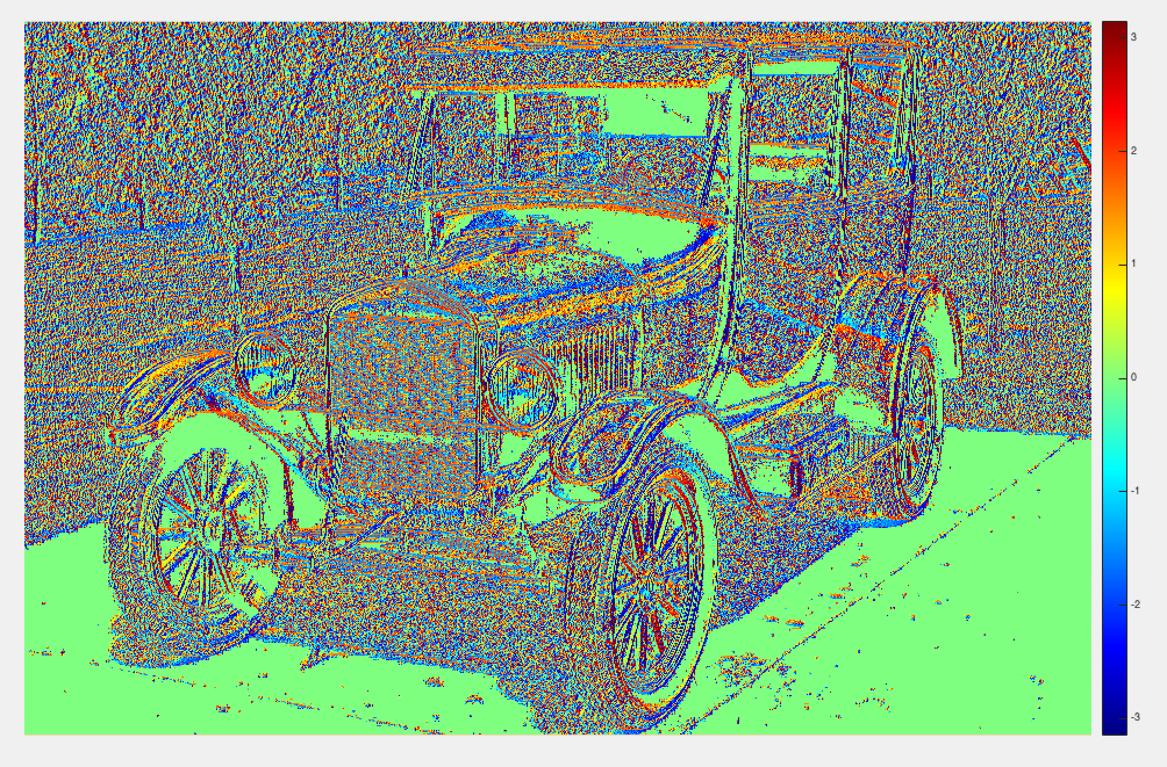
Visualization of gradient detection

Slide 6
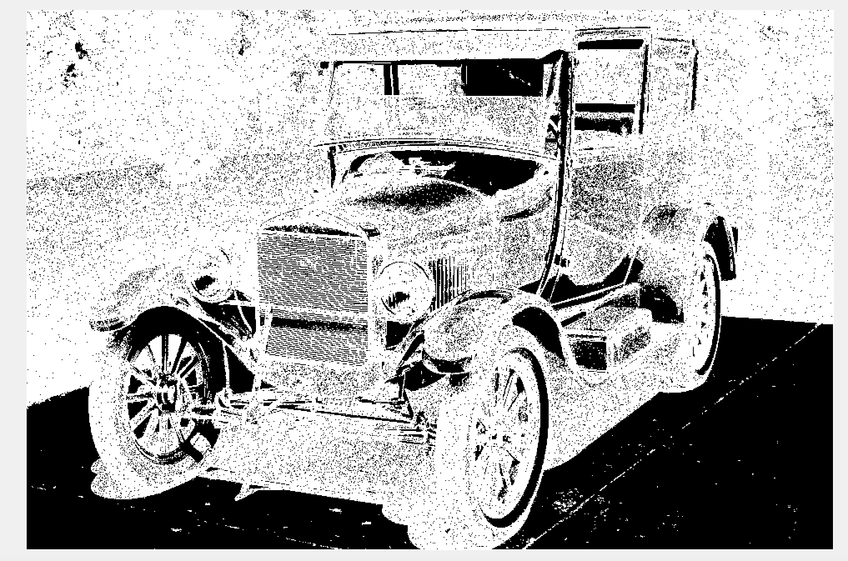
Edge detection visualization for threshold = 1

Slide 7
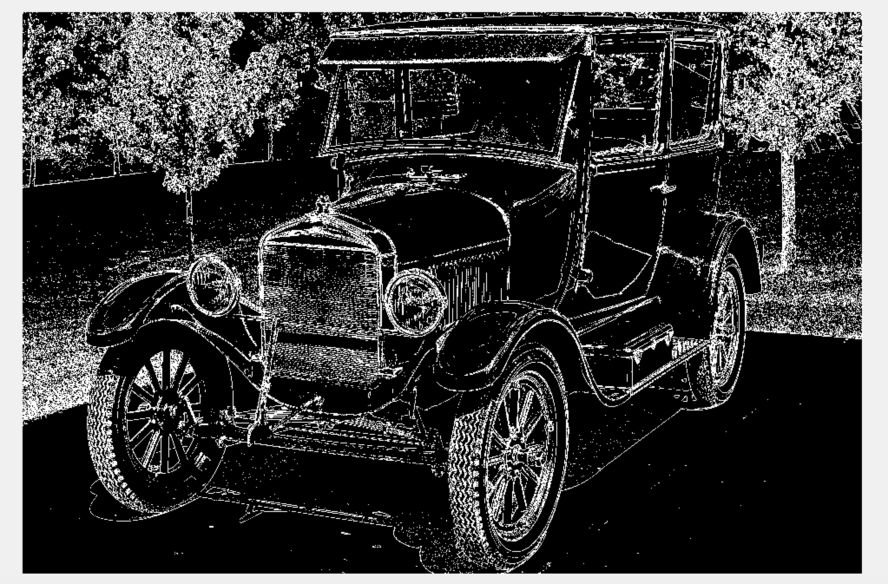
Edge detection visualization for threshold = 10

Slide 8
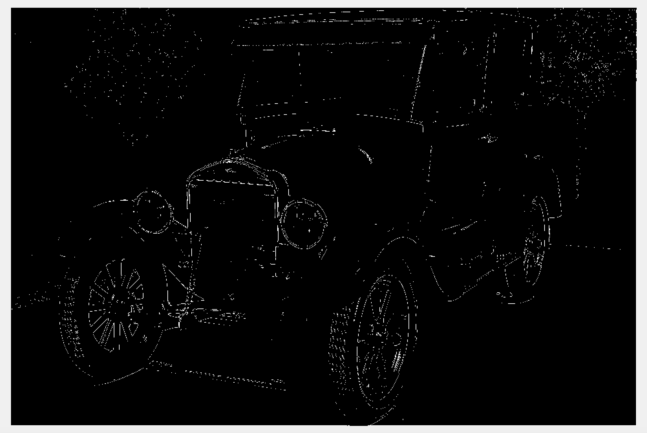
Edge detection visualization for threshold = 50

